Slide 1
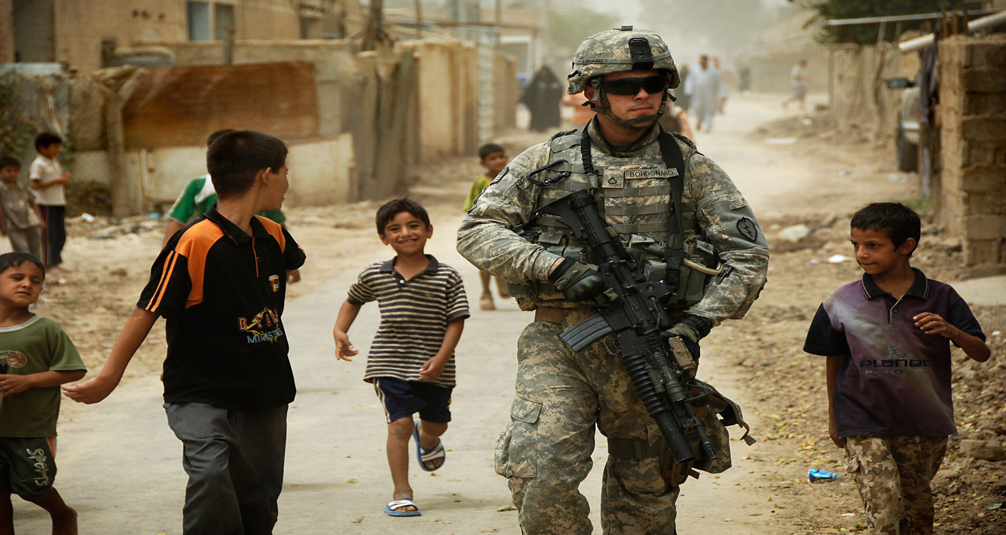
Global Security Issues
In a globalized world, there is bound to be conflict.

Slide 2
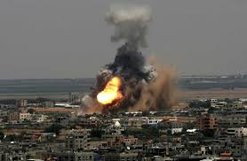
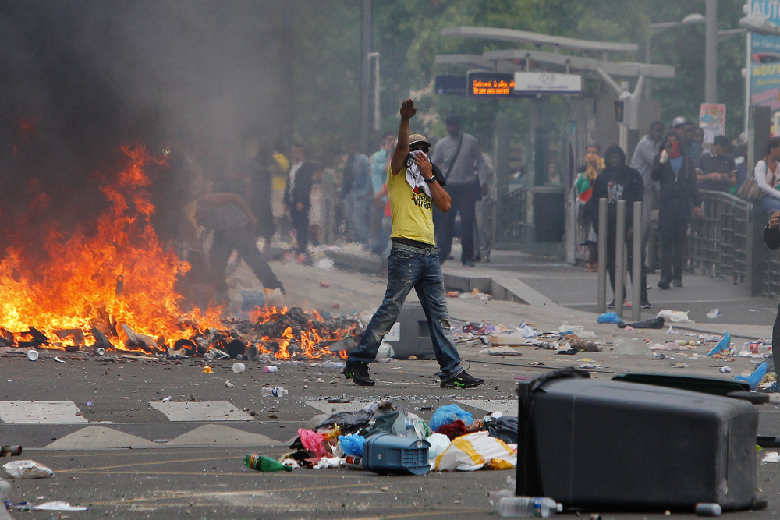
Conflict hotspots today
As we look at the map, let’s make some general observations.
(notice to that the map is from the Center for Foreign Policy which is a U.S. organization.)
http://www.cfr.org/global/global-conflict-tracker/p32137#!/

Slide 3
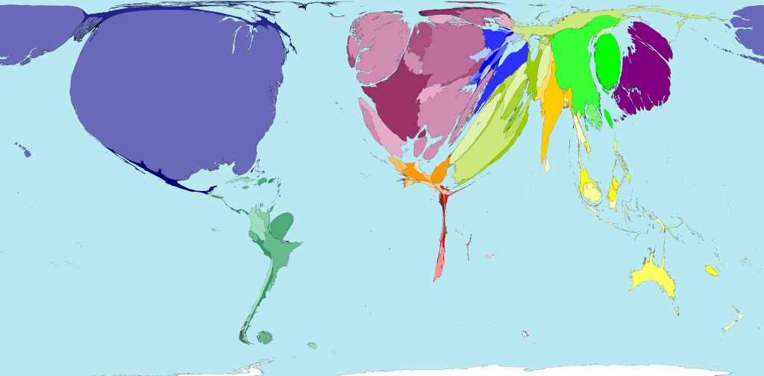
Military Spending Cartogram

Slide 4
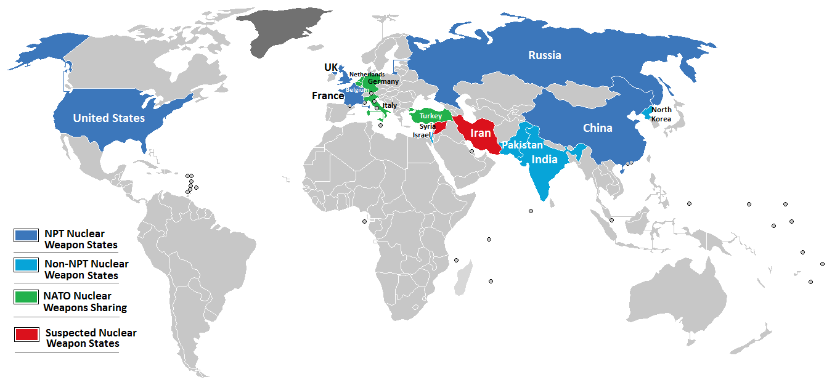
Nuclear Weapons ☹
Cartogram of nations with nuclear weapons: http://www.worldmapper.org/display.php?selected=289

Slide 5
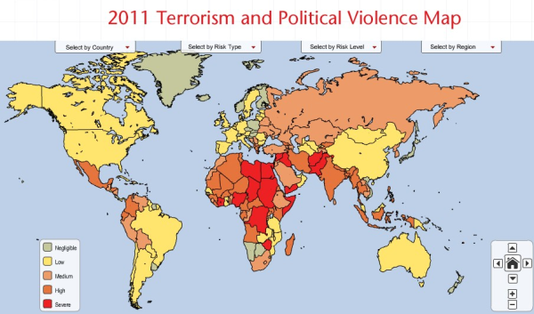
Terrorism and Political Violence Map

Slide 6
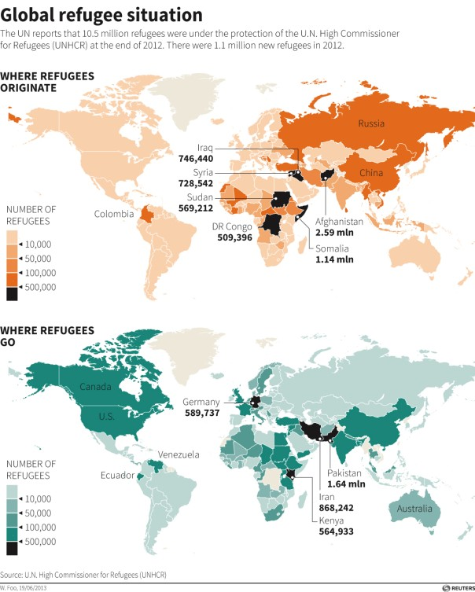
Political violence and persecution (a “push factor”) leads to forced migration.
Refugees

